Slide 1
ECONOMETRIC METHODS IN DATA SCIENCE

Slide 2
What is Econometrics?

Slide 3
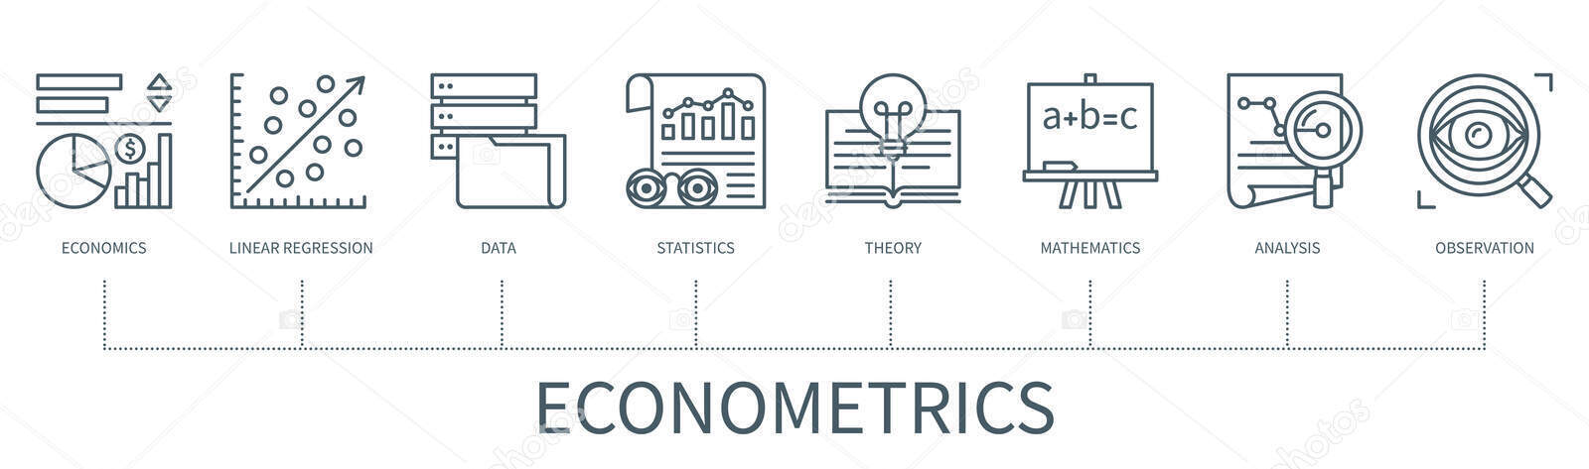
WHAT IS ECONOMETRICS ?
Econometrics is a branch of economics that uses mathematical and statistical models to analyze the data and forecast future events.

Slide 4
Machine Learning
There are two types of econometrics:
Theoretical Econometrics : It is concerned with the development of appropriate methods for measuring economic relationships specified by econometric models. For example, OLS, 2SLS, etc.
Applied Econometrics: It is the use of tools of theoretical econometrics to study some specified fields of economics and business.
TYPES OF ECONOMETRICS

Slide 5
LOGISTIC REGRESSION
ORDINARY LEAST SQUARE (OSL)
TWO STAGE LEAST SQUARE (2SLS)
SOME OF THE METHODS IN
ECONOMETICS
ARE…

Slide 6
LOGISTIC REGRESSION

Slide 7
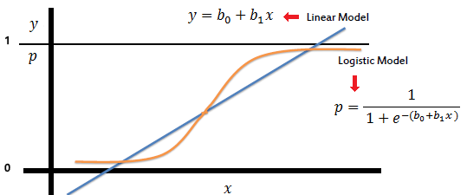
WHAT IS LOGISTIC REGRESSION ?
Contrary to its name, Logistic Regression is a classification algorithm used to predict categorical values.
For example , you can predict whether a penguin is happy or sad based on different features

Slide 8
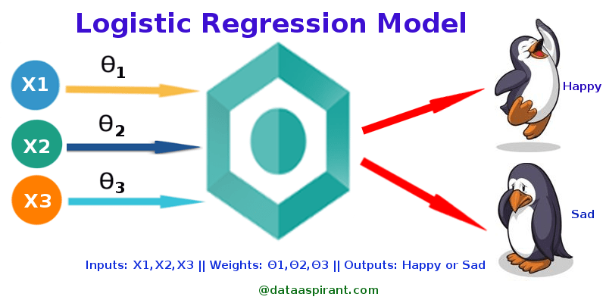
WHEN TO USE IT ?
It can be used when your prediction is categorical , for example , it can be used to determine the probability of something being “true or false” and also for deciding between two outcomes like “yes or no”.
Best fit for this model is a sigmoid curve unlike a straight line which is in Linear Regression
Output is determined based on the maximum of probabilities of the result belonging to each class.

Slide 9
HOW TO USE IT ?
Logistic Regression in python is implemented in two ways – Manually or by using Libraries which is the most preferred method.
To implement Logistic Regression with libraries following steps are to be considered:
Collecting the appropriate data
Pre process the data by removing null values , normalizing the data , etc.
Create the model from the library (here ‘sklearn’)
Fitting the data to the model
Evaluating the final model.

Slide 10
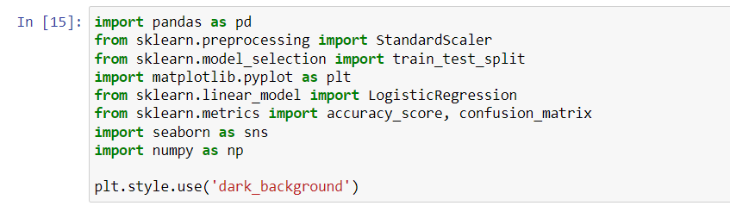
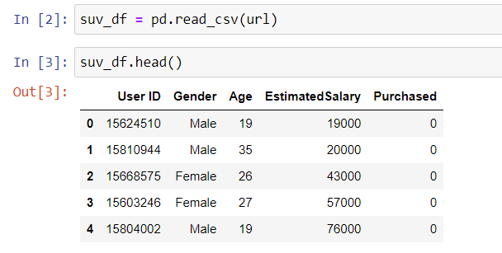
IMPLEMENTATION
First, import the required Libraries
Then, get a suitable dataset.

Slide 11
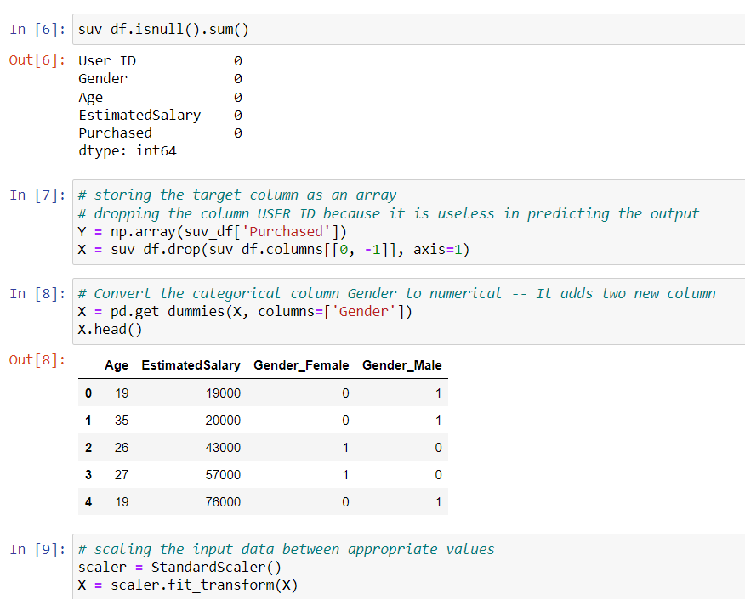
IMPLEMENTATION
Modify the data by removing null values , converting the categorical columns to numerical and normalizing the data.

Slide 12
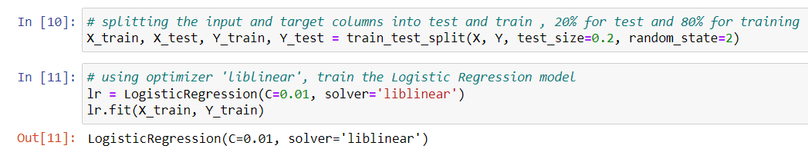
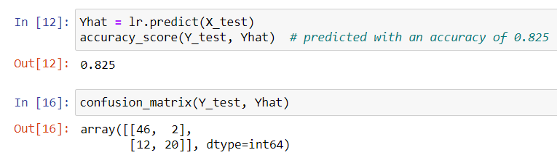
IMPLEMENTATION
Split the dataset into Training and Testing dataset and train the model using the Training data
Test the model on the Testing dataset and get its accuracy score and find a confusion matrix if needed.
Logistic Regression is thus implemented.

Slide 13
ORDINARY LEAST SQUARE ( OSL )

Slide 14
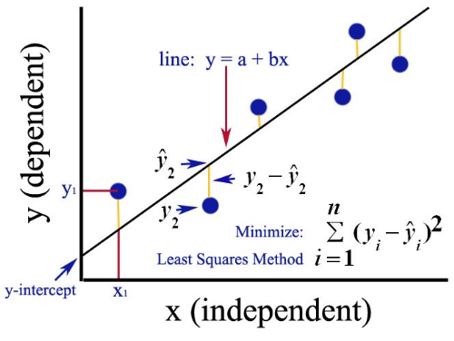
WHAT IS ORDINARY LEAST SQUARE (OSL) ?
Ordinary Least Square is one of the types of Linear Regression or rather, it is a method for implementing linear regression.
The part where it differs from simple linear regression is that it finds the parameters of the best fit line by minimizing the sum of squared errors.

Slide 15
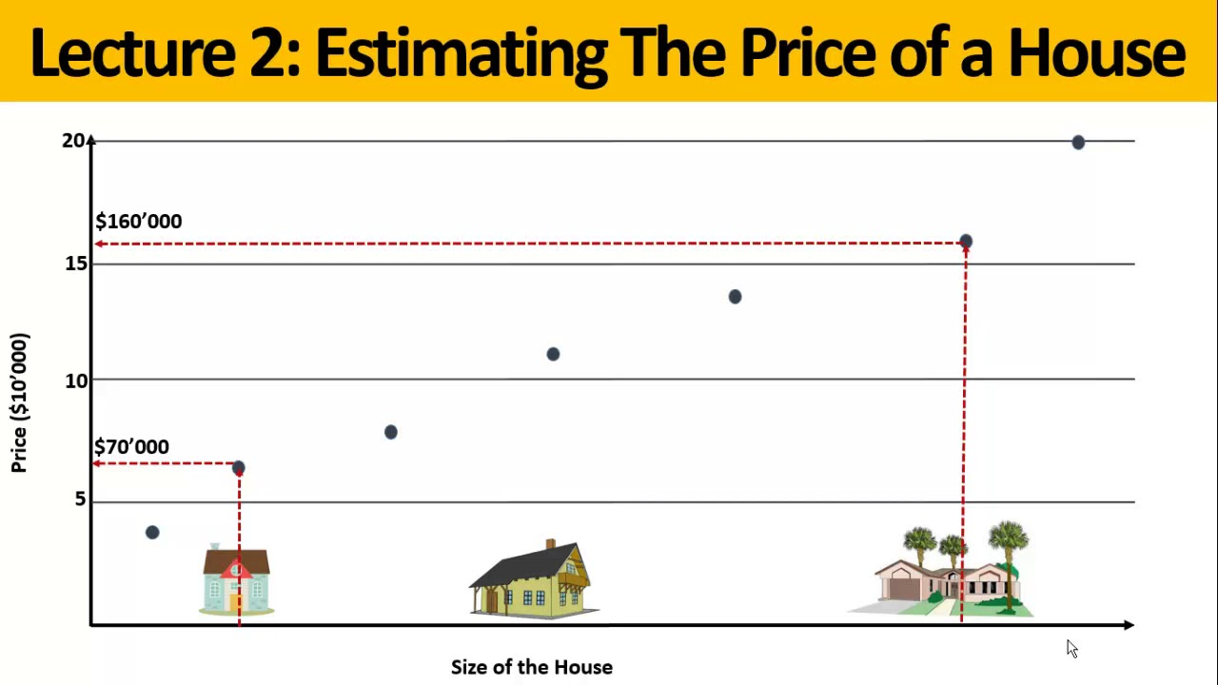
WHEN TO USE IT ?
It can be used when you want to predict a continuous value based on various input values.
For example, predicting the price of a house based on various features like size of the house, size of the lot or number of bedrooms, etc.

Slide 16
HOW TO USE IT ?
OLS like every other method can be implemented manually but we implement it using appropriate libraries.
To implement:
Get the data
Normalize the data, check for null values and convert categorical data to numerical
Add a constant as a new feature to the data.
Create a model using the imported libraries and fit the data to it
Evaluate the trained model and make use of different hyperparameters to increase accuracy score

Slide 17

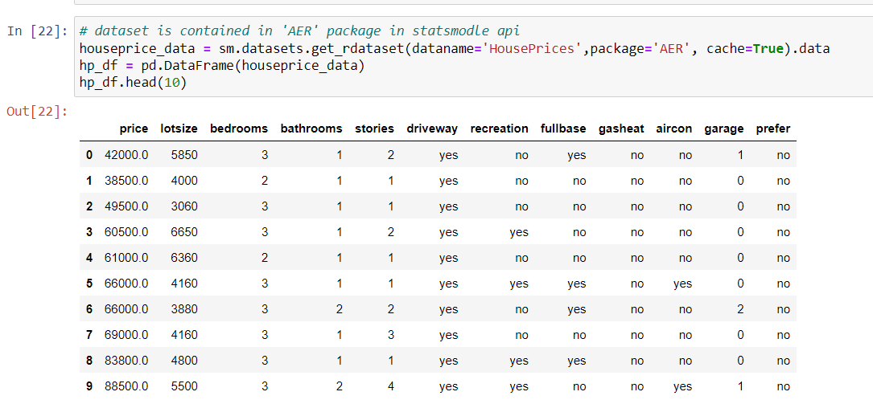
IMPLEMENTATION
Again , begin by importing the required libraries
Then, get a suitable dataset

Slide 18
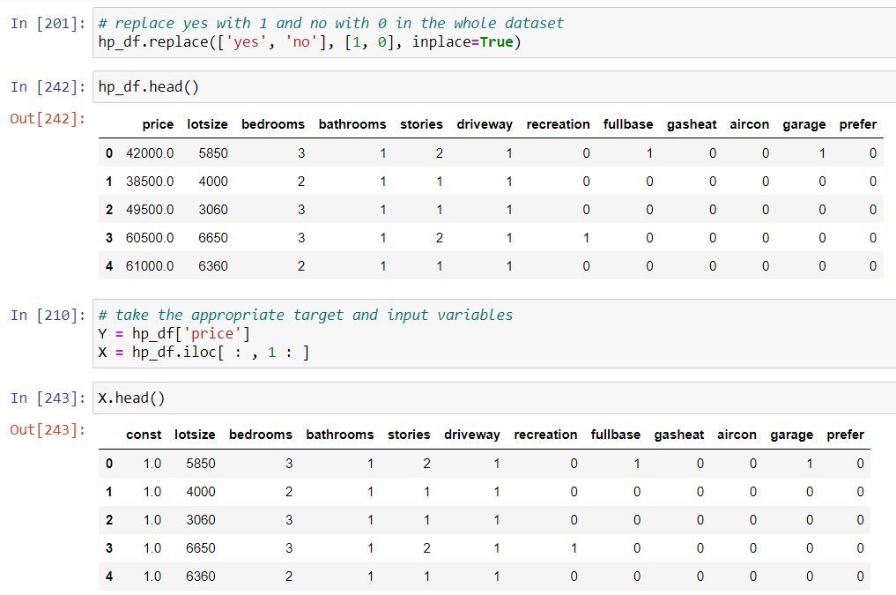
IMPLEMENTATION
Modify the data by removing null values , converting the categorical columns to numerical and normalizing the data, etc.

Slide 19
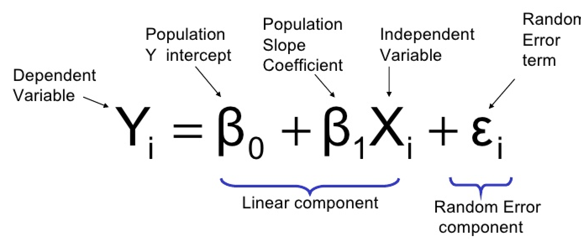
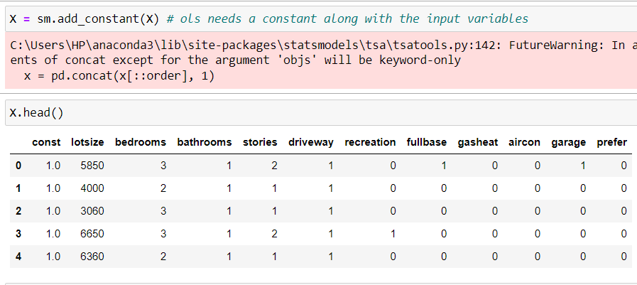
IMPLEMENTATION
Add a constant (here 1) to the input variables , as OLS uses a constant or an intercept to complete the equation :

Slide 20
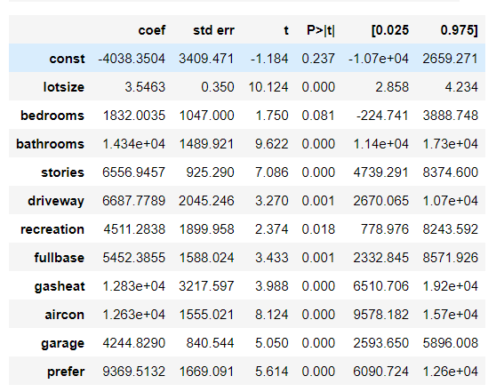
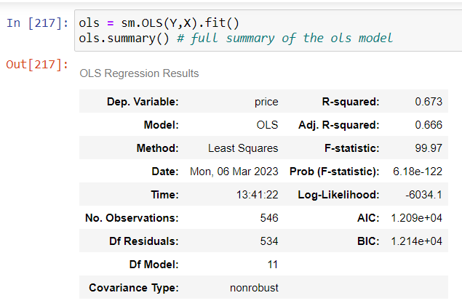
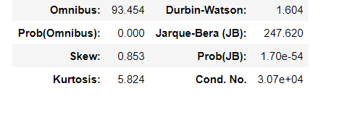
IMPLEMENTATION
Fit the model with the dataset and find the evaluate the model by using “.summary()” method

Slide 21
TWO STAGE LEAST SQUARE ( OSL )

Slide 22
WHAT IS TWO STAGE LEAST SQUARE (2SLS) ?
Like Ordinary Least Square, Two Stage Least Square is also a method in Linear Regression .
It works in two stages :
First, predicting the values of the problematic feature using other features.
Second, combining those values along with values of other columns to predict the value of final dependent variable
Terms :
Endogenous - A variable that is influenced by other variables in the model and can have an effect on the error term and the prediction.
Exogenous - A variable that isn’t influenced by any other variable in the model.
Dependent – A variable whose value is to be predicted.
Instrument – A variable that is correlated with the endogenous variable but not with the dependent variable.

Slide 23
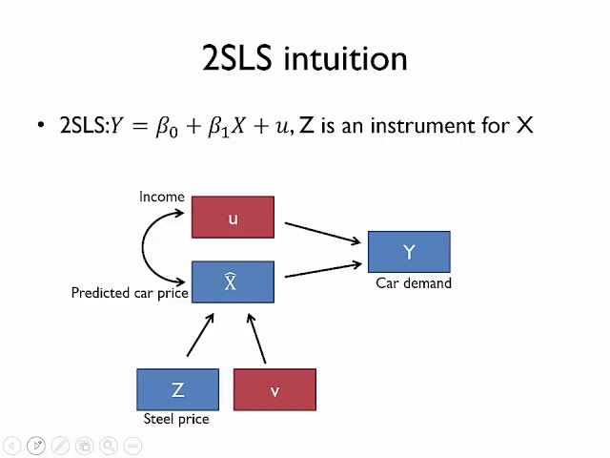
WHEN TO USE IT ?
It can be used when there is an endogenous variable affecting the predictions of the model.
For example, In predicting the demand of a car based on various features, one of the feature “car price” depends on some other feature like “steel price”.
We then use steel price to predict the new values for car price, and then use those values to predict the car demand.

Slide 24
HOW TO USE IT ?
To implement:
Get the data
Normalize the data, check for null values and convert categorical data to numerical
Find the dependent, endogenous, exogenous, and instrument variables and divide the data accordingly.
Make sure to not include instrument variables with the exogenous variables as they are supposed to affect only the endogenous variable.
Create the model using a library (here ‘linearmodels’ ) and fit the data accordingly
Evaluate the trained model.

Slide 25
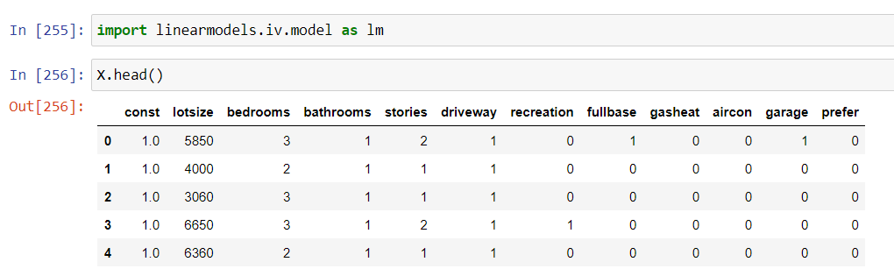
IMPLEMENTATION
Again , begin by importing the required libraries and getting the required dataset.
Here we will use the same dataset used for ordinary least square .
Same procedure will be followed for altering the values in data as we followed in OLS

Slide 26
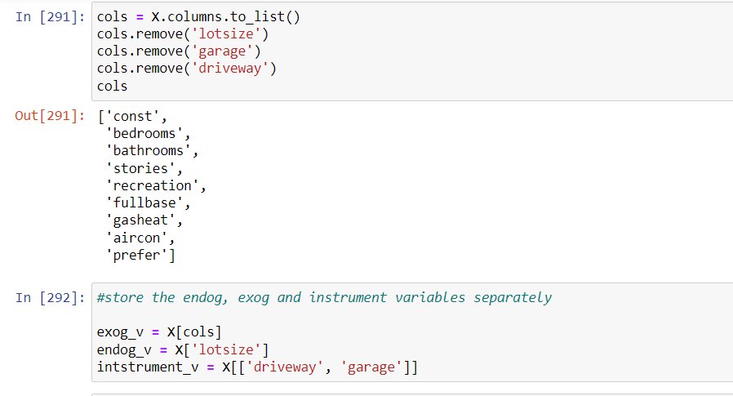
IMPLEMENTATION
Let’s just store endogenous, exogenous and instrument variables separately.
Fit the model with all the stored variables. Use appropriate parameters for the model.

Slide 27
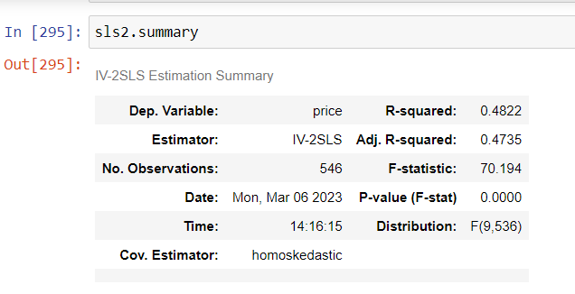
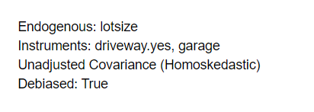
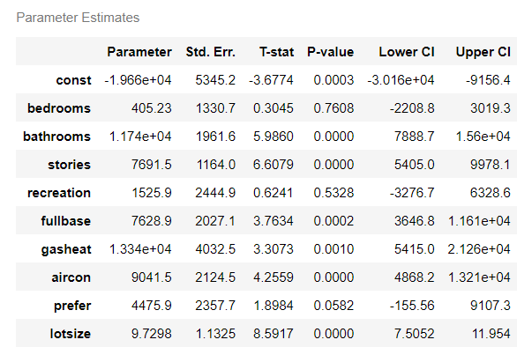
IMPLEMENTATION
Evaluate your fitted model and explore the coefficients assigned to each variable.

Slide 28
THANK YOU !

